Slide 1

Web Traffic Time series forecasting
Submitted by-
Nikhil Verma
Man Mohan Nayak
M B Manikanta Reddy

Slide 2
Problem Statement
Nowadays, web traffic forecasting is a major problem as this can cause setbacks to the workings of major websites. Forecasting the web traffic helps in providing a secure, reliable web service. Web traffic time series analysis is used by web service provider to determine popularity and usage pattern of webpages which can be used to structure the web pages to provide reliable service. In this project we are doing analysis on the daily usage statistics of Wikipedia pages and create a model to predict the future usage of pages.

Slide 3
Literature Survey
Authors | Year of publication | Summary
Navyasree Petluri, Eyhab Al-Masri | 2018 | Uses RNN seq2seq model with the Encoder/decoder Architecture.
Shiva Prakash, Santhi Thilagam, and N. Mohan Kumar | 2018 | Uses three different techniques, namely Discrete Wavelet Transform (DWT), Autoregressive Integrated Moving Average (ARIMA), and Recurrent Neural Network (RNN) to predict network traffic volume.
Roberto Casado-Vara 1, Angel Martin del Rey, Daniel Pérez-Palau, Luis de-la-Fuente-Valentín and Juan M. Corchado | 2021 | Proposes a distributed and asynchronous training method for LSTM networks to improve the training process and overcome the limitations of traditional training methods.
Sikai Zhang, Hong Zheng, Hongyi Su, Bo Yan, Jiamou Liu, Song Yang | 2021 | proposes a novel neural network architecture, called GACAN, for traffic forecasting based on multi-granularity time series data.

Slide 4
Literature Survey
Authors | Year of Publication | Summary
Tejas Shelatkar, Stephen Tondale, Swaraj Yadav ,and Sheetal Ahir. | 2020 | presents a comparative study of two different methods for web traffic time series forecasting: the Autoregressive Integrated Moving Average (ARIMA) model and the Long Short-Term Memory Recurrent Neural Network (LSTM RNN) model.
H Yang, X Li, W Qiang, Y Zhao, W Zhang, C Tang | 2021 | proposes a method for network traffic forecasting that combines ARIMA and BP Neural Network with simulated annealing (SA) optimization.
Szostak, Daniel | 2021 | Proposes machine learning methods for network traffic prediction in optical network.
K Zhou, W Wang, L Huang, B Liu | 2021 | Comparative study on the time series forecasting of web traffic based on statistical model and Generative Adversarial model

Slide 5
Dataset Description
The training dataset consists of approximately 145k time series. Each of these time series represent a number of daily views of a different Wikipedia article starting from July, 1st, 2015 up until March 1st, 2017.
The dataset consists of two .csv files namely train1 and train2.
For training a model we have taken data from July,1st,2015 to August,10st,2017. and for testing the models we are predicting web traffic for last 31 and 60 days in case of ANN.
The dataset has daily views of Wikipedia pages as Wikipedia has pages in different languages, on analysis we have found that time series of different language has different characteristics.

Slide 6
DatA Analysis
A stationary time series is a type of time series where the statistical properties of the series remain constant over time. This means that the mean, variance, and autocorrelation of the series do not change with time.
To test for stationarity we have done dicky fuller test for different language pages.
url category | Stationarity
Chinese, Zhōnghuá | Non-stationary
English | Non-stationary
Japenese | Non-stationary
Spanish | Stationary
French | Stationary
ns | Stationary
ww | Stationary
Russian | Stationary
German | Stationary

Slide 7
Augmented Dicky Fuller Test
This test checks if the data is stationary or not.
It is a hypothesis testing in which the null hypothesis is that the data is non-stationary.
p-value > 0.05: Fail to reject the null hypothesis (H0), the data has a unit root and is non-stationary.
p-value <= 0.05: Reject the null hypothesis (H0), the data does not have a unit root and is stationary.
The p-value in the augmented Dickey-Fuller (ADF) test is a measure of the strength of evidence against the null hypothesis of a unit root in a time series.
The test statistic is a t-statistic, and its critical values are determined by the number of observations, the level of significance, and the order of the autoregressive model.

Slide 8
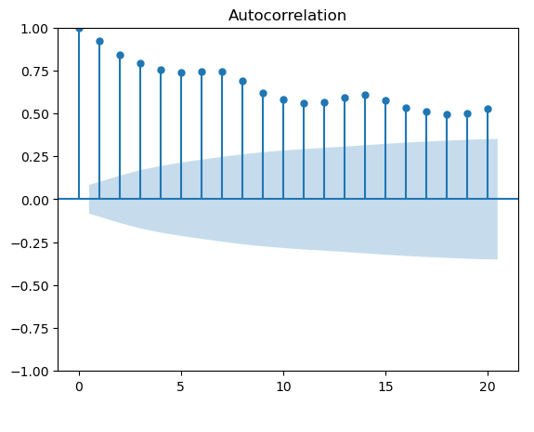
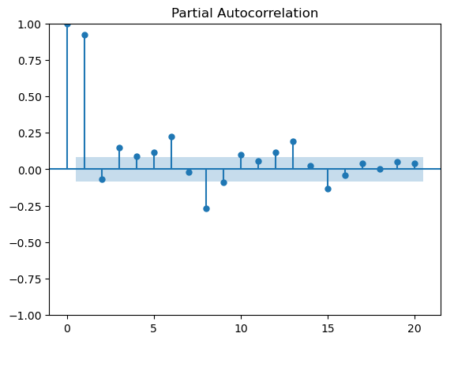
Methodology -1
To determine the value of p, q, d plotting ACF and PACF.

Slide 9
Methodology -2
From ACF and PACF the value of p, q, and d are –
P = 5 as all value are out of significance level
Q = 30 as 30 observations are more than significant level.
D = 1 as some observation in data are stationary and some are non stationary we cannot determine order of differencing so taking it randomly as 1.

Slide 10
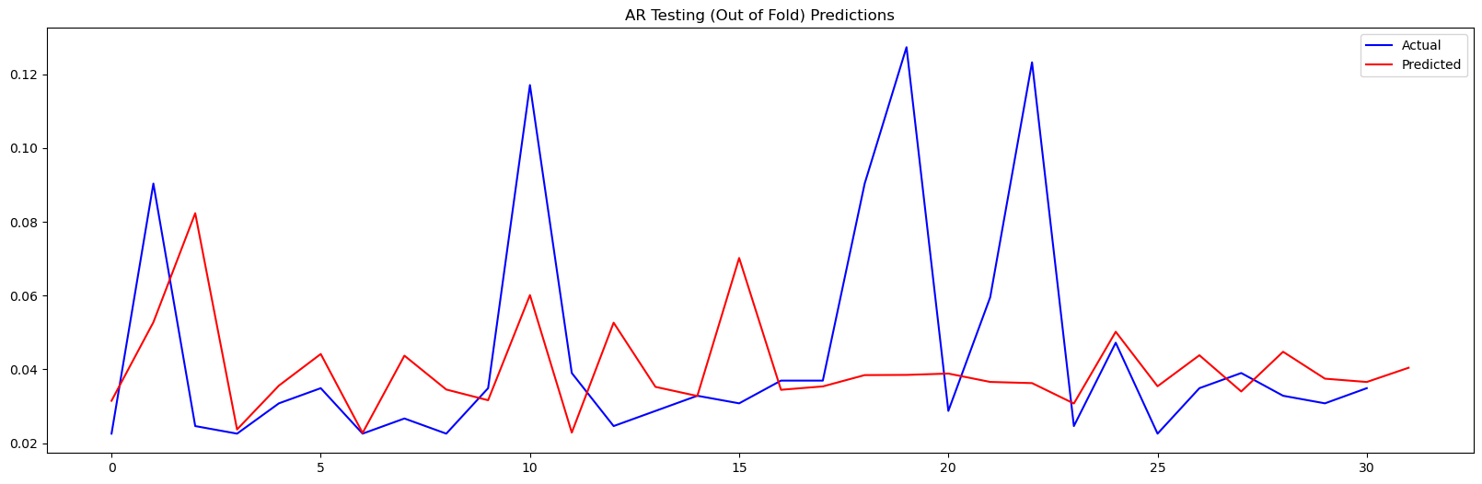
Auto Regressive Model (AR)
It is a type of linear model where the current value of a time series variable is expressed as a linear combination of its past values and a random error term.
Y_t = c + Σ_{i=1}^{p} ϕ_i Y_{t-i} + ε_t
Plot of prediction for next 31 days –

Slide 11
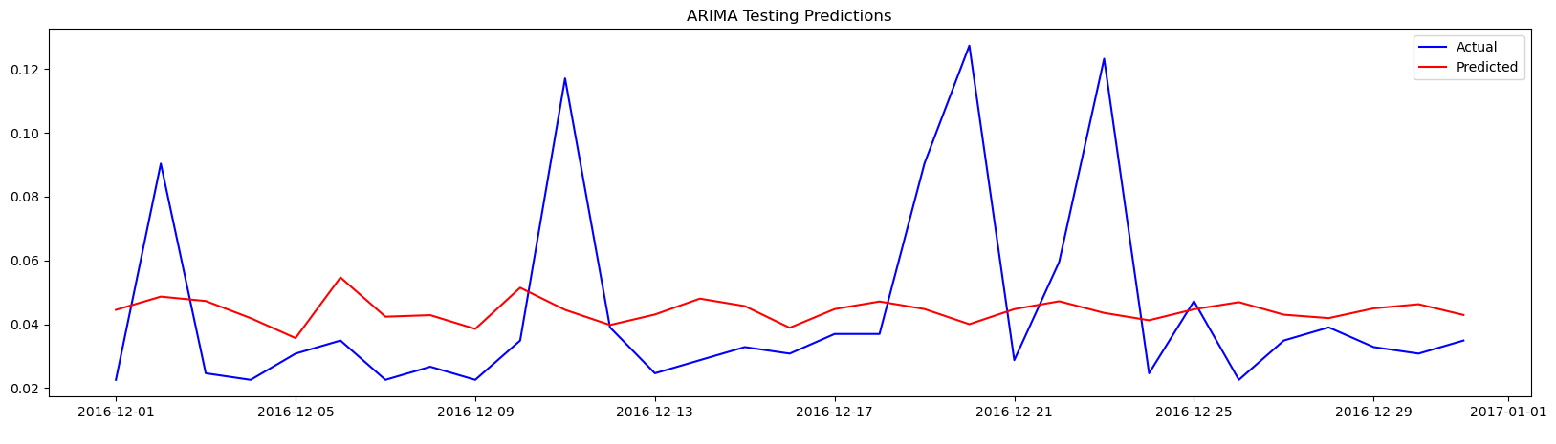
Autoregressive Integrated Moving Average (ARIMA)
It is an extension of the AR model that also includes the integration and moving average components.
Mathematically, an ARIMA(p, d, q) model can be written as:
y’(t) = c + ϕ1* y′(t−1) +⋯ + ϕp*y′(t−p) + θ1*ε(t−1) +⋯ + θq*ε(t−q) + εt
Plot of actual and predicted value for next 31 days-

Slide 12
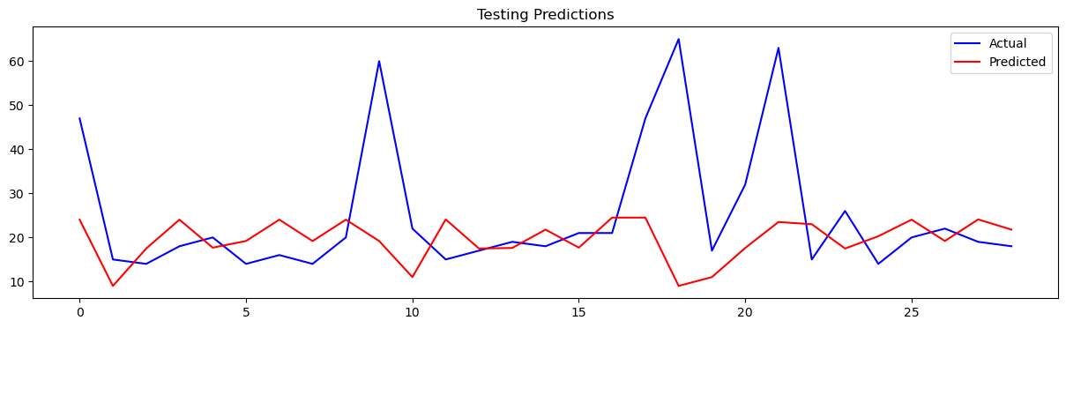
Xtreme gradient boosting (XGBOOST)
It is an extension of the gradient boosting method, which uses an ensemble of decision trees to make predictions.
XGBoost for time series forecasting uses a rolling window technique.
Plot of actual and predicted value for next 31 days-

Slide 13
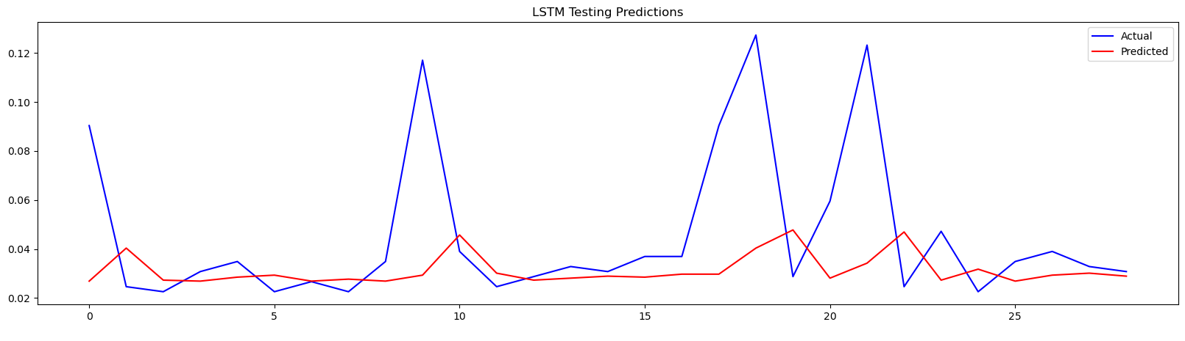
Long short term memory (lstm)
It is a type of recurrent neural network (RNN) that is commonly used for sequence modeling and time series forecasting.
An LSTM network can remember long term dependency and has cell that can store information over multiple steps.
Plot of actual and predicted value for next 31 days-

Slide 14
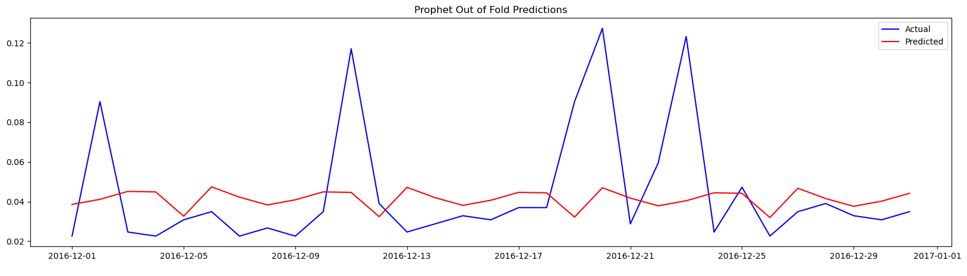
Facebook Prophet
It is a time series forecasting tool developed by Facebook's Core Data Science team. It is an open-source tool that can be used to model and forecast time series data with daily, weekly, and yearly seasonality.
y(t) = g(t) + s(t) + h(t) + ε_t
y(t) is the observed value at time t, g(t) is a piecewise linear or logistic growth curve for modeling trend, s(t) represents seasonality (daily, weekly, yearly), h(t) represents holiday effects, and ε_t is the error term.
Plot of actual and predicted value for next 31 days-

Slide 15
ARTIFICIAL NEURAL NETWORK (ANN) -1
A deep neural network is a very powerful tool to learn time series modeling. As there are large numbers of layers and trainable parameters, a deep neural network can model complex dependency in time series.
The model has in total 48657 trainable parameters.
In this for validation set we are using same time range as training set, but the validation set is shifted forward for 60 days in time.
We are using mean absolute error as loss function.
For 10 epochs the deep learning model is giving validation loss of .2448 which is very low compared to other models.

Slide 16
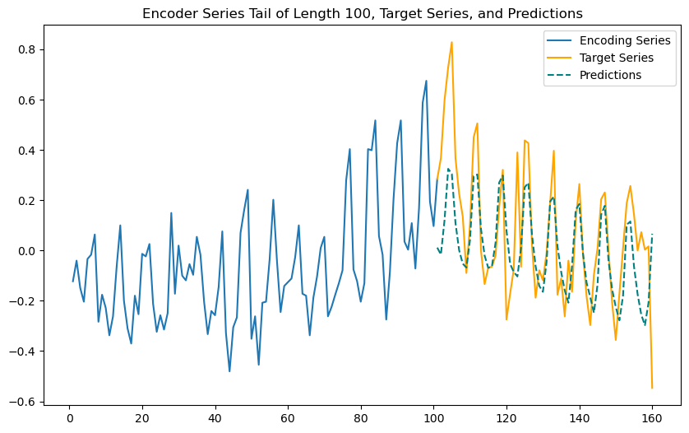
ARTIFICIAL NEURAL NETWORK (ANN) -2
Plot of actual and predicted values of next 60 days –

Slide 17
Comparison - 1
1. Comparing the results of ANN model with "Web traffic prediction of wikipedia pages." by Petluri, Navyasree, and Eyhab Al-Masri.
SMAPE of model in paper – 0.351
SMAPE of proposed ANN model – 0.15
from Symmetric mean absolute percentage error(SMAPE) it is clear that out proposed
ANN model has better performance than the model proposed in paper.

Slide 18
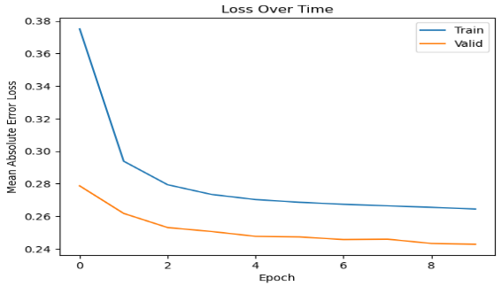
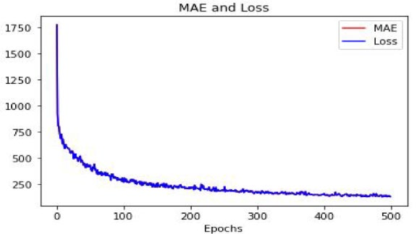
Comparison -2
Comparing the result of ANN modle with "Web traffic time series forecasting using LSTM neural networks with distributed asynchronous training." by Casado-Vara, Roberto.
plot of MAE loss and number of epochs in LSTM neural network.
MAE achieved – 132.26
plot of MAE loss and number of epochs in proposed ANN model.
MAE achieved – 0.24
from the performance matrix and error vs epochs graph it is clear that the propose ANN model is giving better performance.

Slide 19

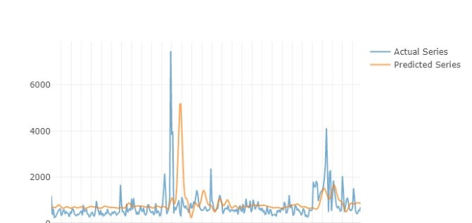
Comparison -3
Comparing the result of ANN modle with Web traffic time series forecasting using ARIMA and LSTM RNN." by Tejas Shelatkar, Stephen Tondale, Swaraj Yadav ,and Sheetal Ahir. plot of web traffic in the next 15 days-

Slide 20
Result & conclusion
As the time series data has stationary and non-stationary component the AR, ARIMA, Prophet model were unable to properly model the data.
As the ANN model has large number of trainable parameters to model complex changes in time series, it is able to model the time series and make prediction.

Slide 21
References
Petluri, Navyasree, and Eyhab Al-Masri. "Web traffic prediction of wikipedia pages." 2018 IEEE International Conference on Big Data (Big Data). IEEE, 2018.
Madan, Rishabh, and Partha Sarathi Mangipudi. "Predicting computer network traffic: a time series forecasting approach using DWT, ARIMA and RNN." 2018 Eleventh International Conference on Contemporary Computing (IC3). IEEE, 2018.
Casado-Vara, Roberto, et al. "Web traffic time series forecasting using LSTM neural networks with distributed asynchronous training." Mathematics 9.4 (2021): 421.
Zhang, Sikai, et al. "GACAN: Graph Attention-Convolution-Attention Networks for Traffic Forecasting Based on Multi-granularity Time Series." arXiv preprint arXiv:2110.14331 (2021).
Shelatkar, Tejas, et al. "Web traffic time series forecasting using ARIMA and LSTM RNN." ITM Web of Conferences. Vol. 32. EDP Sciences, 2020.
Yang, Hanyu, et al. "A network traffic forecasting method based on SA optimized ARIMA–BP neural network." Computer Networks 193 (2021): 108102.
Szostak, Daniel. "Machine learning ensemble methods for optical network traffic prediction." 14th International Conference on Computational Intelligence in Security for Information Systems and 12th International Conference on European Transnational Educational (CISIS 2021 and ICEUTE 2021) 14. Springer International Publishing, 2022.
Zhou, Kun, et al. "Comparative study on the time series forecasting of web traffic based on statistical model and Generative Adversarial model." Knowledge-Based Systems 213 (2021): 106467.

Slide 22
Thank You

